Slide 1
Lecture
Time Value of Money and Debt Financing
11
L.O. Appendix G-1: Interest and future values
L.O. Appendix G-2: Present values
L.O. 10-2: Major bond characteristics
L.O. 10-3: Accounting for bond transactions

Slide 2
Learning Objective Appendix G-1
Interest and Future Values

Slide 3
Outline
Time value of money
Nature of interest
Future value concepts
Future value of a single amount
Future value of an annuity

Slide 4
Time Value of Money
Would you rather receive $1,000 today or in a year from now?
Today! “Interest Factor”

Slide 5
Nature of Interest
Payment for the use of money.
Difference between amount borrowed or invested (principal) and amount repaid or collected.
Elements involved in financing transaction:
Principal (p): Amount borrowed or invested.
Interest Rate (i): An annual percentage.
Time (n): Number of years or portion of a year that the principal is borrowed or invested.

Slide 6
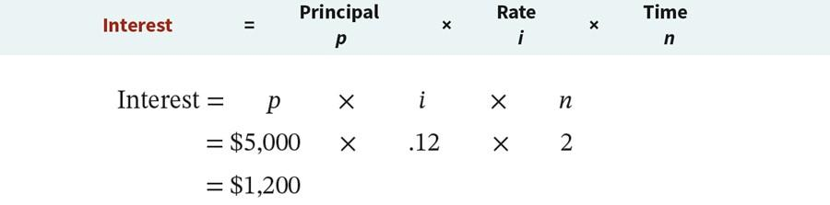
Nature of Interest
Simple Interest
Interest computed on the principal only.
Illustration: Assume you borrow $5,000 for 2 years at a simple interest rate of 12% annually. Calculate the total interest cost for 2 years.

Slide 7
Nature of Interest
Compound Interest
Computes interest on
the principal and
any interest earned that has not been paid or withdrawn.
Most business situations use compound interest.

Slide 8
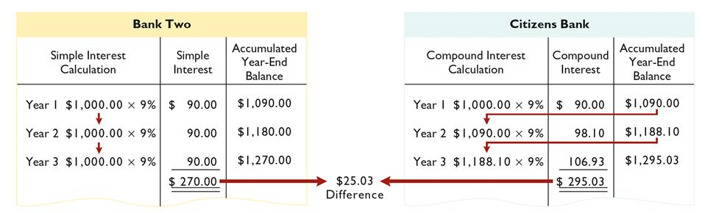
Nature of Interest
Simple Interest and Compound Interest Compared
Illustration: Assume that you deposit $1,000 in Bank Two, where it will earn simple interest of 9% per year, and you deposit another $1,000 in Citizens Bank, where it will earn compound interest of 9% per year compounded annually. Also assume that in both cases you will not withdraw any cash until three years from the date of deposit.

Slide 9
Future Value Concepts
Future value of a single amount is the value at a future date of a given amount invested, assuming compound interest.
FV = future value of a single amount
p = principal (or present value; the value today)
i = interest rate for one period
n = number of periods

Slide 10
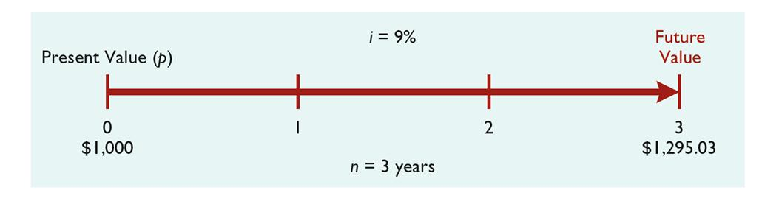
Future Value of a Single Amount
Illustration: If you want a 9% rate of return, you would compute the future value of a $1,000 investment for three years as follows:

Slide 11
Future Value of a Single Amount
What Table Do We Use?
Illustration: If you want a 9% rate of return, you would compute the future value of a $1,000 investment for three years as follows:
Use the Future Value of 1 Table where n is the number of compounding periods, the percentages are the periodic interest rates, and the 5-digits decimal numbers in the respective columns are the future value of 1 factors.

Slide 12
Future Value of a Single Amount
What Table Do We Use?
Table 1 Future Value of 1
(n) Periods | 4% | 5% | 6% | 7% | 8% | 9% | 10%
0 | 1.00000 | 1.00000 | 1.00000 | 1.00000 | 1.00000 | 1.00000 | 1.00000
1 | 1.04000 | 1.05000 | 1.06000 | 1.07000 | 1.08000 | 1.09000 | 1.10000
2 | 1.08160 | 1.10250 | 1.12360 | 1.14490 | 1.16640 | 1.18810 | 1.21000
3 | 1.12486 | 1.15763 | 1.19102 | 1.22504 | 1.25971 | 1.29503 | 1.33100
4 | 1.16986 | 1.21551 | 1.26248 | 1.31080 | 1.36049 | 1.41158 | 1.46410
5 | 1.21665 | 1.27628 | 1.33823 | 1.40255 | 1.46933 | 1.53862 | 1.61051

Slide 13
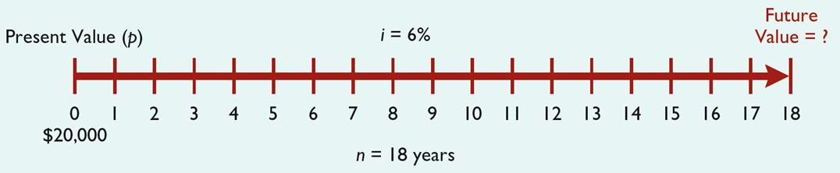
Future Value of a Single Amount
Decide on Table to Use
Illustration:
John and Mary Rich invested $20,000 in a savings account paying 6% interest at the time their son, Mike, was born. The money is to be used by Mike for his college education. On his 18th birthday, Mike withdraws the money from his savings account. How much did Mike withdraw from his account?

Slide 14
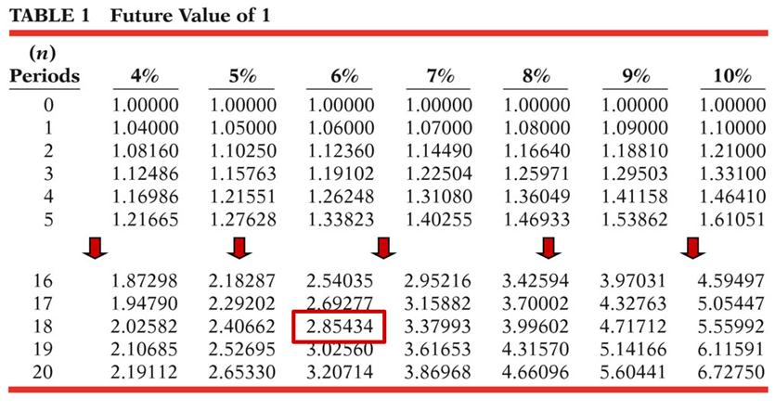
Future Value of a Single Amount
Decide on Factor to Use

Slide 15
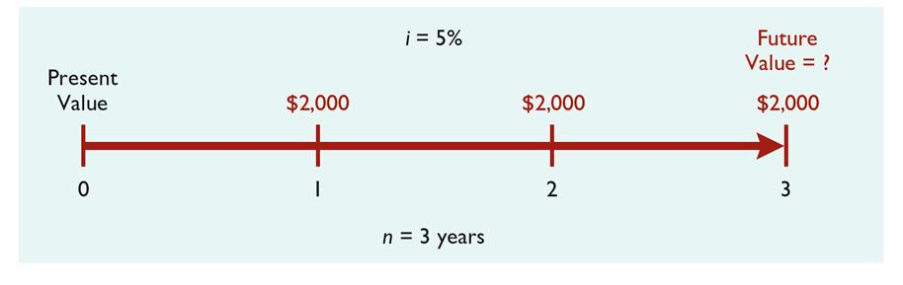
Future Value of an Annuity
Illustration: Assume that you invest $2,000 at the end of each year for three years at 5% interest compounded annually.

Slide 16
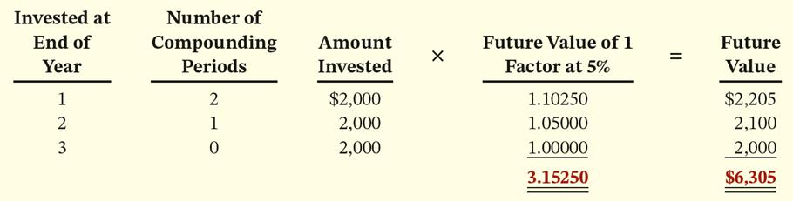
Future Value of an Annuity
Using Future Value of 1 Table
Table 1 Future Value of 1
(n) Periods | 4% | 5% | 6% | 7%
0 | 1.00000 | 1.00000 | 1.00000 | 1.00000
1 | 1.04000 | 1.05000 | 1.06000 | 1.07000
2 | 1.08160 | 1.10250 | 1.12360 | 1.14490
3 | 1.12486 | 1.15763 | 1.19102 | 1.22504

Slide 17
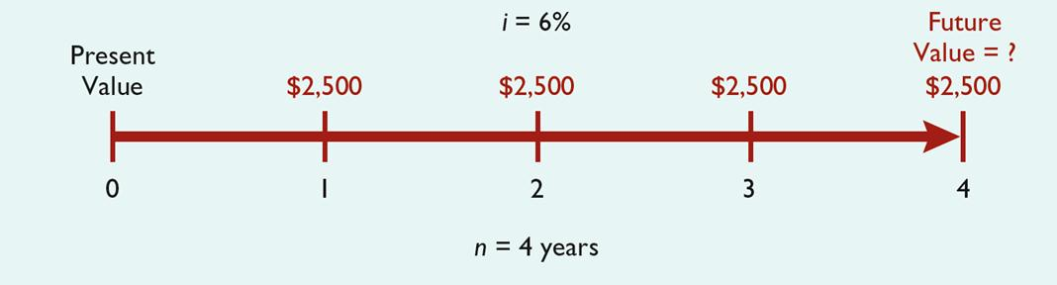
Future Value of an Annuity
Another Example
When the periodic payments (receipts) are the same in each period, the future value can be computed by using a Future Value of an Annuity of 1 Table.
Illustration: John and Char Lewis's daughter, Debra, has just started high school. They decide to start a college fund for her and will invest $2,500 in a savings account at the end of each year she is in high school (4 payments total). The account will earn 6% interest compounded annually. How much will be in the college fund at the time Debra graduates from high school?

Slide 18
Future Value of an Annuity
Using Future Value of an Annuity of 1 Table
Table 2 Future Value of an Annuity of 1
(n) Payments | 4% | 5% | 6% | 7% | 8% | 9%
1 | 1.00000 | 1.00000 | 1.00000 | 1.0000 | 1.00000 | 1.00000
2 | 2.04000 | 2.05000 | 2.06000 | 2.0700 | 2.08000 | 2.09000
3 | 3.12160 | 3.15250 | 3.18360 | 3.2149 | 3.24640 | 3.27810
4 | 4.24646 | 4.31013 | 4.37462 | 4.4399 | 4.50611 | 4.57313
5 | 5.41632 | 5.52563 | 5.63709 | 5.7507 | 5.86660 | 5.98471
What factor do we use?

Slide 19
Learning Objective Appendix G-2
Present Values

Slide 20
Outline
Present value variables
Present value of a single amount
Present value of an annuity
Time periods and discounting

Slide 21
Present Value Variables
The present value is the value now of a given amount to be paid or received in the future, assuming compound interest.
Present value variables:
Dollar amount to be received (future amount).
Length of time until amount is received (number of periods).
Interest rate (the discount rate).

Slide 22
Present Value of a Single Amount
FV = future value
PV = present value
i = interest rate for one period
n = number of periods

Slide 23
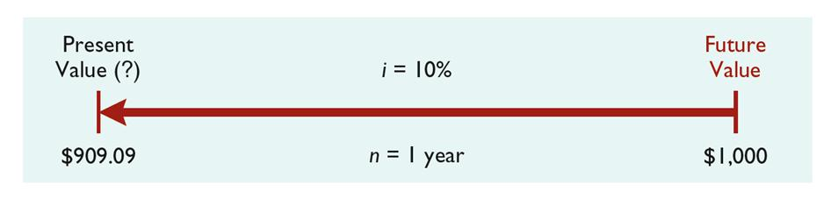
Present Value of a Single Amount
Illustration: If you want a 10% rate of return, you would compute the present value of $1,000 for one year as follows:

Slide 24
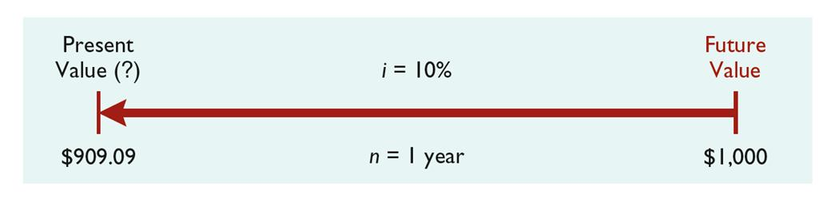
Present Value of a Single Amount
What Table Do We Use?
Illustration: If you want a 10% rate of return, you can also compute the present value of $1,000 for one year by using a Present Value of 1 Table.

Slide 25
Present Value of a Single Amount
What Factor Do We Use?
Table 3 Present Value of 1
(n) Periods | 4% | 5% | 6% | 7% | 8% | 9% | 10%
1 | .96154 | .95238 | .94340 | .93458 | .92593 | .91743 | .90909
2 | .92456 | .90703 | .89000 | .87344 | .85734 | .84168 | .82645
3 | .88900 | .86384 | .83962 | .81630 | .79383 | .77218 | .75132
4 | .85480 | .82270 | .79209 | .76290 | .73503 | .70843 | .68301
5 | .82193 | .78353 | .74726 | .71299 | .68058 | .64993 | .62092

Slide 26
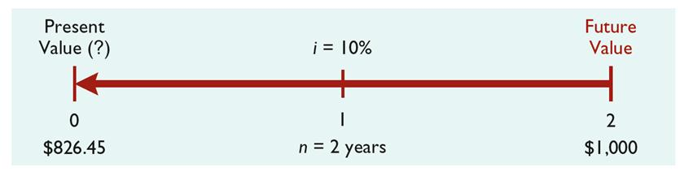
Present Value of a Single Amount
Decide on Table to Use
Illustration: If the single amount of $1,000 is to be received in two years and discounted at 10%, the formula PV = $1,000 ÷ (1 + .10)² is used, where (1 + .10)² is equal to 1.21 (1.10 x 1.10). Its present value is $826.45 ($1,000 ÷ 1.21). Or, you can compute the present value of $1,000 in two years discounted at 10% by using the Present Value of a 1 Table.

Slide 27
Present Value of a Single Amount
Decide on Factor to Use
Table 3 Present Value of 1
(n) Periods | 4% | 5% | 6% | 7% | 8% | 9% | 10%
1 | .96154 | .95238 | .94340 | .93458 | .92593 | .91743 | .90909
2 | .92456 | .90703 | .89000 | .87344 | .85734 | .84168 | .82645
3 | .88900 | .86384 | .83962 | .81630 | .79383 | .77218 | .75132
4 | .85480 | .82270 | .79209 | .76290 | .73503 | .70843 | .68301
5 | .82193 | .78353 | .74726 | .71299 | .68058 | .64993 | .62092

Slide 28
Present Value of a Single Amount
Example
Illustration: Suppose you have a winning lottery ticket and the state gives you the option of taking $10,000 three years from now or taking the present value of $10,000 now. The state uses an 8% rate in discounting. How much will you receive if you accept your winnings now?
Table 3 Present Value of 1
(n) Periods | 4% | 5% | 6% | 7% | 8% | 9% | 10%
1 | .96154 | .95238 | .94340 | .93458 | .92593 | .91743 | .90909
2 | .92456 | .90703 | .89000 | .87344 | .85734 | .84168 | .82645
3 | .88900 | .86384 | .83962 | .81630 | .79383 | .77218 | .75132
4 | .85480 | .82270 | .79209 | .76290 | .73503 | .70843 | .68301
5 | .82193 | .78353 | .74726 | .71299 | .68058 | .64993 | .62092

Slide 29
Present Value of a Single Amount
Another Example
Illustration: Determine the amount you must deposit today in your SUPER savings account, paying 9% interest, in order to accumulate $5,000 for a down payment four years from now on a new car.
Table 3 Present Value of 1
(n) Periods | 4% | 5% | 6% | 7% | 8% | 9% | 10%
1 | .96154 | .95238 | .94340 | .93458 | .92593 | .91743 | .90909
2 | .92456 | .90703 | .89000 | .87344 | .85734 | .84168 | .82645
3 | .88900 | .86384 | .83962 | .81630 | .79383 | .77218 | .75132
4 | .85480 | .82270 | .79209 | .76290 | .73503 | .70843 | .68301
5 | .82193 | .78353 | .74726 | .71299 | .68058 | .64993 | .62092

Slide 30
Present Value of an Annuity
The value now of a series of future receipts or payments, discounted assuming compound interest.
It is necessary to know the:
Discount rate.
Number of payments (receipts).
Amount of the periodic payments or receipts.

Slide 31
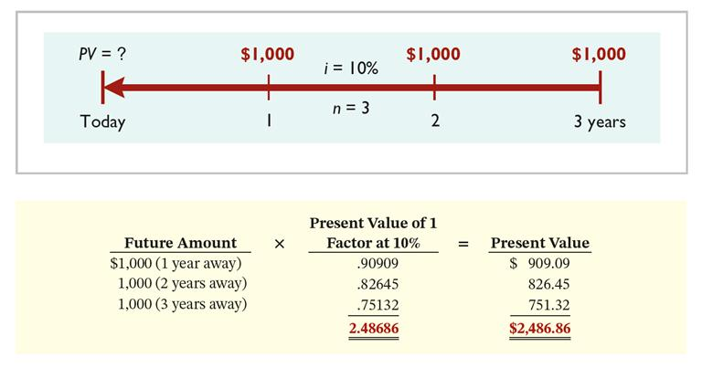
Present Value of an Annuity
Using the Present Value of 1 Table
Illustration: Assume that you will receive $1,000 cash annually for three years at a time when the discount rate is 10%. Calculate the present value in this situation.

Slide 32
Present Value of an Annuity
Using the Present Value of an Annuity of 1 Table
Another way to solve for the present value of $1,000 cash receipts annually for three years when the discount rate is 10% is to use the Present Value of an Annuity of 1 Table.
TABLE 4 Present Value of an Annuity of 1
(n) Payments | 4% | 5% | 6% | 7% | 8% | 9% | 10%
1 | .96154 | .95238 | .94340 | .93458 | .92593 | .91743 | .90909
2 | 1.88609 | 1.85941 | 1.83339 | 1.80802 | 1.78326 | 1.75911 | 1.73554
3 | 2.77509 | 2.72325 | 2.67301 | 2.62432 | 2.57710 | 2.53130 | 2.48685
4 | 3.62990 | 3.54595 | 3.46511 | 3.38721 | 3.31213 | 3.23972 | 3.16986
5 | 4.45182 | 4.32948 | 4.21236 | 4.10020 | 3.99271 | 3.88965 | 3.79079

Slide 33
Present Value of an Annuity
Another Example
Illustration: Kildare Company has just signed a capitalizable lease contract for equipment that requires rental payments of $6,000 each, to be paid at the end of each of the next five years. The appropriate discount rate is 12%. What is the amount used to capitalize the leased equipment?
TABLE 4 Present Value of an Annuity of 1
(n) Payments | 4% | 5% | 6% | 7% | 8% | 9% | 10% | 11% | 12%
1 | .96154 | .95238 | .94340 | .93458 | .92593 | .91743 | .90909 | .90090 | .89286
2 | 1.88609 | 1.85941 | 1.83339 | 1.80802 | 1.78326 | 1.75911 | 1.73554 | 1.71252 | 1.69005
3 | 2.77509 | 2.72325 | 2.67301 | 2.62432 | 2.57710 | 2.53130 | 2.48685 | 2.44371 | 2.40183
4 | 3.62990 | 3.54595 | 3.46511 | 3.38721 | 3.31213 | 3.23972 | 3.16986 | 3.10245 | 3.03735
5 | 4.45182 | 4.32948 | 4.21236 | 4.10020 | 3.99271 | 3.88965 | 3.79079 | 3.69590 | 3.60478

Slide 34
Time Periods and Discounting
Illustration: Assume that an investor receives $500 semiannually for three years when the discount rate was 10%. Calculate the present value of this annuity.
The number of periods becomes six (3 × 2), the discount rate is 5% (10% ÷ 2).
TABLE 4 Present Value of an Annuity of 1
(n) Payments | 4% | 5% | 6% | 7% | 8% | 9% | 10%
1 | .96154 | .95238 | .94340 | .93458 | .92593 | .91743 | .90909
2 | 1.88609 | 1.85941 | 1.83339 | 1.80802 | 1.78326 | 1.75911 | 1.73554
3 | 2.77509 | 2.72325 | 2.67301 | 2.62432 | 2.57710 | 2.53130 | 2.48685
4 | 3.62990 | 3.54595 | 3.46511 | 3.38721 | 3.31213 | 3.23972 | 3.16986
5 | 4.45182 | 4.32948 | 4.21236 | 4.10020 | 3.99271 | 3.88965 | 3.79079
6 | 5.24214 | 5.07569 | 4.91732 | 4.76654 | 4.62288 | 4.48592 | 4.35526
7 | 6.00205 | 5.78637 | 5.58238 | 5.38929 | 5.20637 | 5.03295 | 4.86842
8 | 6.73274 | 6.46321 | 6.20979 | 5.97130 | 5.74664 | 5.53482 | 5.33493

Slide 35
Learning Objective 10-2
Major Bond Characteristics

Slide 36
Outline
What is a bond?
Types of bonds
Issuing procedures
Bond trading
Market price of a bond

Slide 37
What are Bonds?
Long-term liabilities are obligations that are expected to be paid after one year.
Bonds are a form of interest-bearing notes payable.
Sold in small denominations (usually $1,000 or multiples of $1,000).
Attract many investors.
Corporation issuing bonds is borrowing money.
Person who buys the bonds (the bondholder) is investing in bonds.

Slide 38
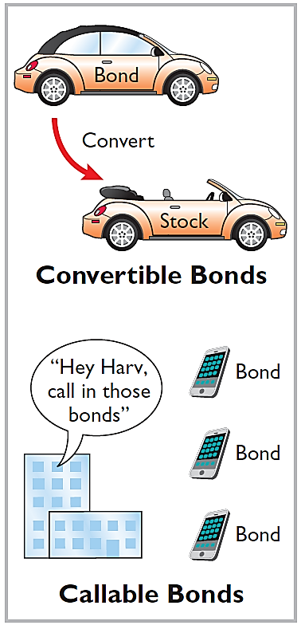
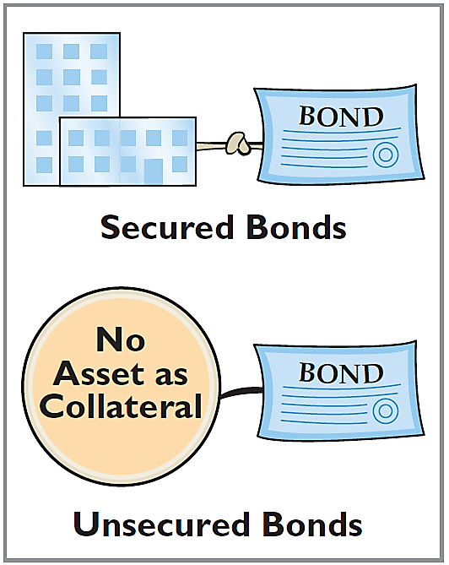
Types of Bonds
Mortgage bond
Sinking fund bond
Debenture bond

Slide 39
Issuing Procedures
State laws grant corporations the power to issue bonds.
Board of directors and stockholders must approve bond issues.
Board of directors must stipulate number of bonds to be authorized, total face value, and contractual interest rate.
Bond terms are set forth in legal document known as a bond indenture.
Trustee keeps records of each bondholder, custody of unissued bonds, holds conditional title to pledged property

Slide 40
Issuing Procedures
Represents a promise to pay:
Sum of money at designated maturity date.
Periodic interest at a contractual (stated) rate on the maturity amount (face value).
Interest payments usually made semiannually.
Issued to obtain large amounts of long-term capital.
Investment company sells the bonds for the issuing company.

Slide 41
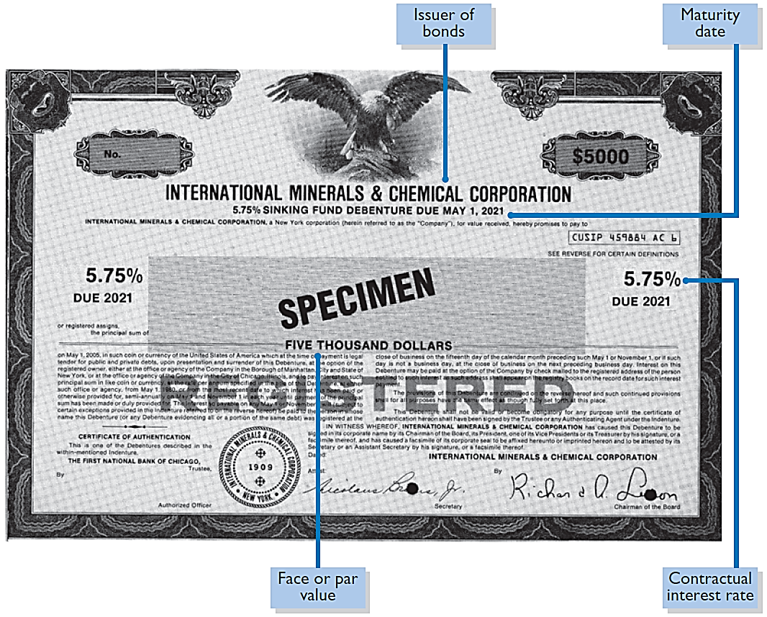
Bond Certificate

Slide 42
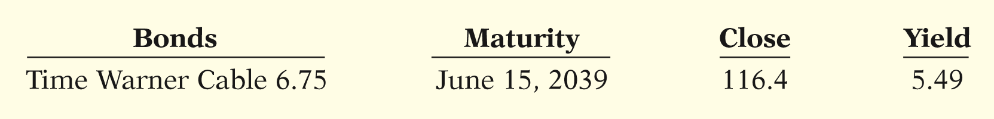
Bond Trading
Bondholders can sell their bonds on national exchanges.
Bond prices are quoted as a percentage of the face value.
A quoted price of 97 means 97% of face value.
Time Warner Cable has outstanding 6.75%, $1,000 bonds that mature in 2039. They currently yield a 5.49% return. At the close of trading, the price was 116.4% of face value, or $1,164.

Slide 43
Determining the Market Value of a Bond
Current market price (present value) is a function of the three factors:
Dollar amounts to be received.
Length of time until the amounts are received.
Market rate of interest.
The market interest rate is the rate investors demand for loaning funds.

Slide 44
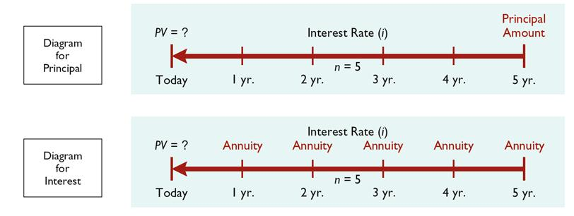
Present Value of a Bond
Two Cash Flows:
Principal paid at maturity (single sum).
Periodic interest payments (annuity).

Slide 45
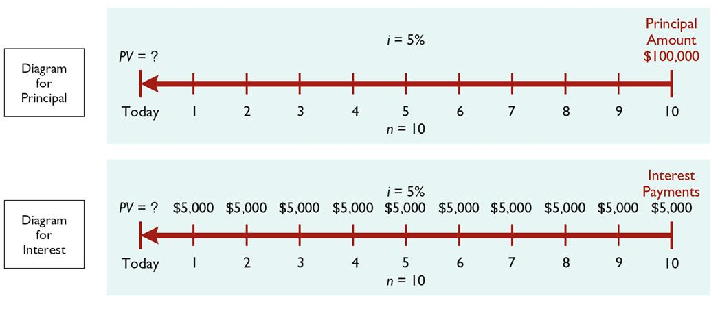
Present Value of a Bond
Illustration: Assume a bond issue of 5%, 10-year bonds with a face value of $100,000 with interest payable annually on January 1.

Slide 46
Present Value of a Bond
Calculation of Present Value of Principal
Table 3 Present Value of 1: PV of Principal
(n) Periods | 4% | 5% | 6% | 7% | 8% | 9% | 10%
1 | .96154 | .95238 | .94340 | .93458 | .92593 | .91743 | .90909
2 | .92456 | .90703 | .89000 | .87344 | .85734 | .84168 | .82645
3 | .88900 | .86384 | .83962 | .81630 | .79383 | .77218 | .75132
4 | .85480 | .82270 | .79209 | .76290 | .73503 | .70843 | .68301
5 | .82193 | .78353 | .74726 | .71299 | .68058 | .64993 | .62092
6 | .79031 | .74622 | .70496 | .66634 | .63017 | .59627 | .56447
7 | .75992 | .71068 | .66506 | .62275 | .58349 | .54703 | .51316
8 | .73069 | .67684 | .62741 | .58201 | .54027 | .50187 | .46651
9 | .70259 | .64461 | .59190 | .54393 | .50025 | .46043 | .42410
10 | .67556 | .61391 | .55839 | .50835 | .46319 | .42241 | .38554

Slide 47
Present Value of a Bond
Calculation of Present Value of Interest Payments
Table 4 Present Value of an Annuity of 1: PV of Interest
(n) Payments | 4% | 5% | 6% | 7% | 8% | 9% | 10%
1 | .96154 | .95238 | .94340 | .93458 | .92593 | .91743 | .90909
2 | 1.88609 | 1.85941 | 1.83339 | 1.80802 | 1.78326 | 1.75911 | 1.73554
3 | 2.77509 | 2.72325 | 2.67301 | 2.62432 | 2.57710 | 2.53130 | 2.48685
4 | 3.62990 | 3.54595 | 3.46511 | 3.38721 | 3.31213 | 3.23972 | 3.16986
5 | 4.45182 | 4.32948 | 4.21236 | 4.10020 | 3.99271 | 3.88965 | 3.79079
6 | 5.24214 | 5.07569 | 4.91732 | 4.76654 | 4.62288 | 4.48592 | 4.35526
7 | 6.00205 | 5.78637 | 5.58238 | 5.38929 | 5.20637 | 5.03295 | 4.86842
8 | 6.73274 | 6.46321 | 6.20979 | 5.97130 | 5.74664 | 5.53482 | 5.33493
9 | 7.43533 | 7.10782 | 6.80169 | 6.51523 | 6.24689 | 5.99525 | 5.75902
10 | 8.11090 | 7.72173 | 7.36009 | 7.02358 | 6.71008 | 6.41766 | 6.14457

Slide 48
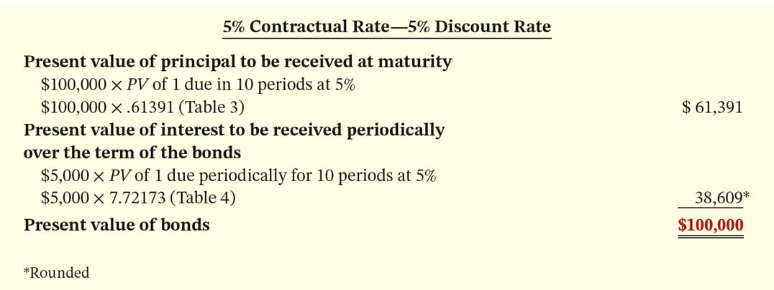
Present Value of a Bond
Example With Contractual Rate of 5% and Discount Rate of 5%
Illustration: Assume a bond issue of 5%, 10-year bonds with a face value of $100,000 with interest payable annually on January 1. Calculate the present value of the principal and interest payments.

Slide 49
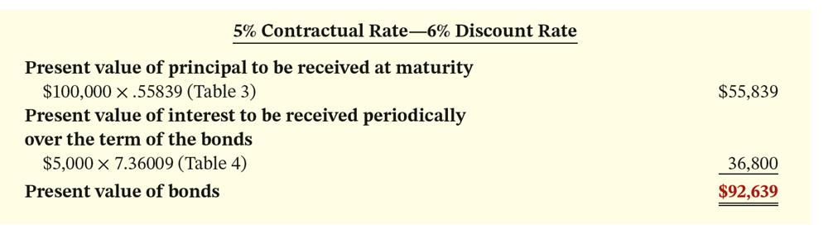
Present Value of a Bond
Example With Contractual Rate of 5% and Discount Rate of 6%
Illustration: Now assume that the investor’s required rate of return is 6%, not 5%. The future amounts are again $100,000 and $5,000, respectively, but now a discount rate of 6% must be used. Calculate the present value of the principal and interest payments.

Slide 50
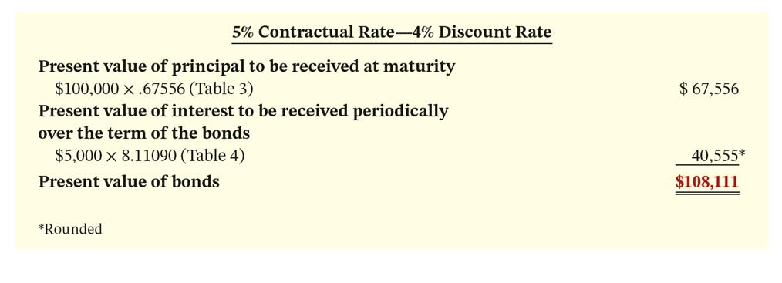
Present Value of a Bond
Example With Contractual Rate of 5% and Discount Rate of 4%
Illustration: Now assume that the investor’s required rate of return is 4%. The future amounts are again $100,000 and $5,000, respectively, but now a discount rate of 4% must be used. Calculate the present value of the principal and interest payments.

Slide 51
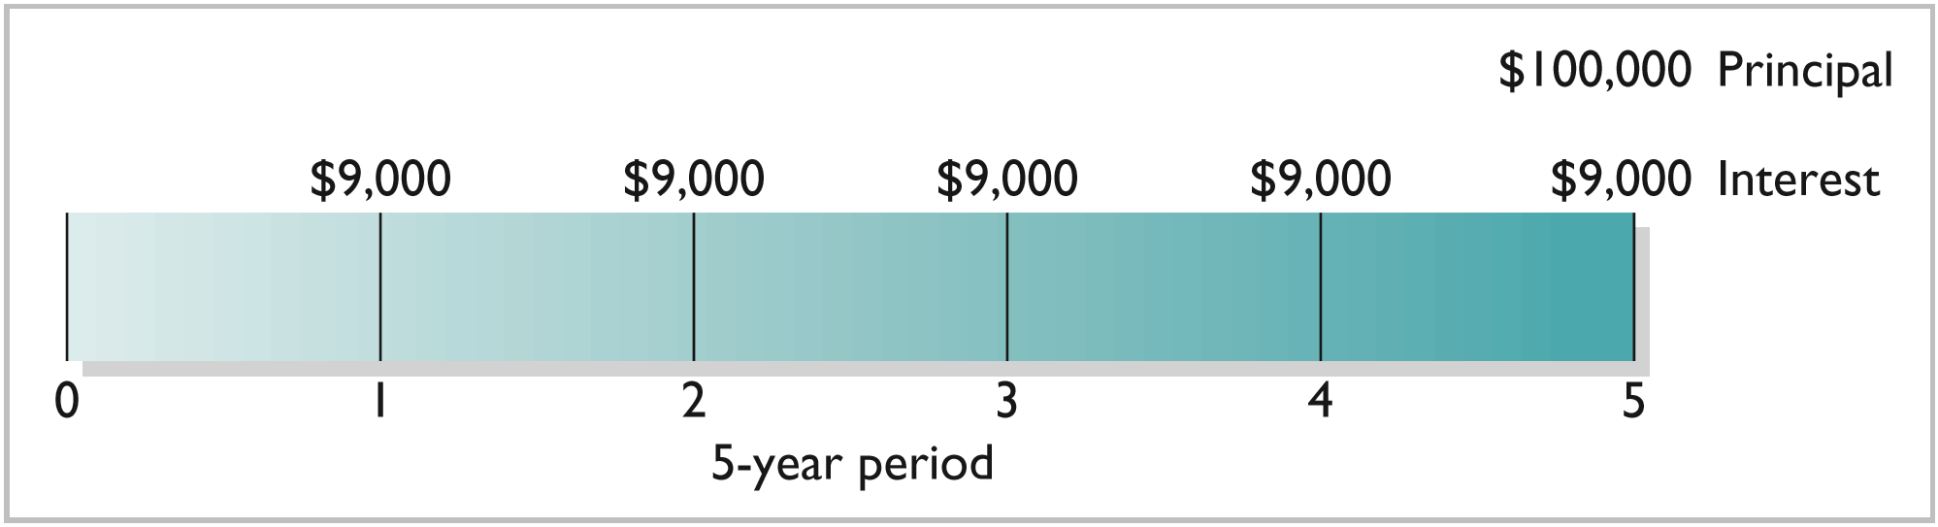
Determining the Market Value of a Bond
Illustration: Assume that Acropolis Company on January 1, 2019, issues $100,000 of 9% bonds, due in five years, with interest payable annually at year-end. The purchaser of the bonds would receive the following two types of cash payments: (1) principal of $100,000 to be paid at maturity, and (2) five $9,000 interest payments ($100,000 × 9%) over the term of the bonds. (Assuming the market interest rate is 9%)

Slide 52
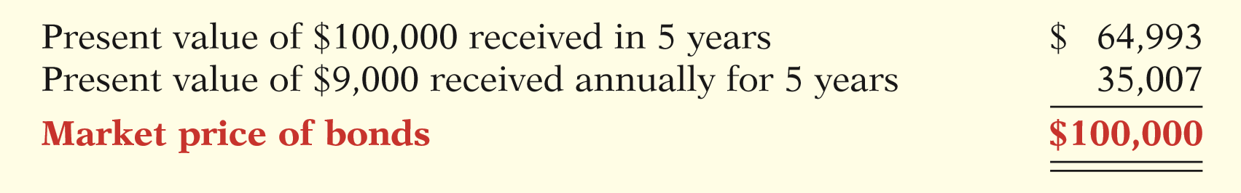
Determining the Market Value of a Bond
Calculation: The current market price of a bond is equal to the present value of all the future cash payments promised by the bond.

Slide 53
DO IT! 2: Bond Terminology
State whether each of the following statements is true or false. If false, indicate how to correct the statement.
True
1. Mortgage bonds and sinking fund bonds are both examples of secured bonds.
True
2. Unsecured bonds are also known as debenture bonds.
False
3. The stated rate is the rate investors demand for loaning funds.
True
4. The face value is the amount of principal the issuing company must pay at the maturity date.
False
5. The market price of a bond is equal to its maturity value.

Slide 54
Learning Objective 10-3
Accounting for Bond Transactions

Slide 55
Outline
Issuing bonds
At face value
At a discount
At a premium
Redeeming bonds

Slide 56
Accounting for Bond Transactions
Corporation records bond transactions when it
Issues (sells).
Redeems (buys back) bonds.
When bondholders convert bonds into common stock.
If bondholders sell their bond investments to other investors, the issuing company receives no further money on the transaction, nor does the issuing company journalize the transaction.

Slide 57
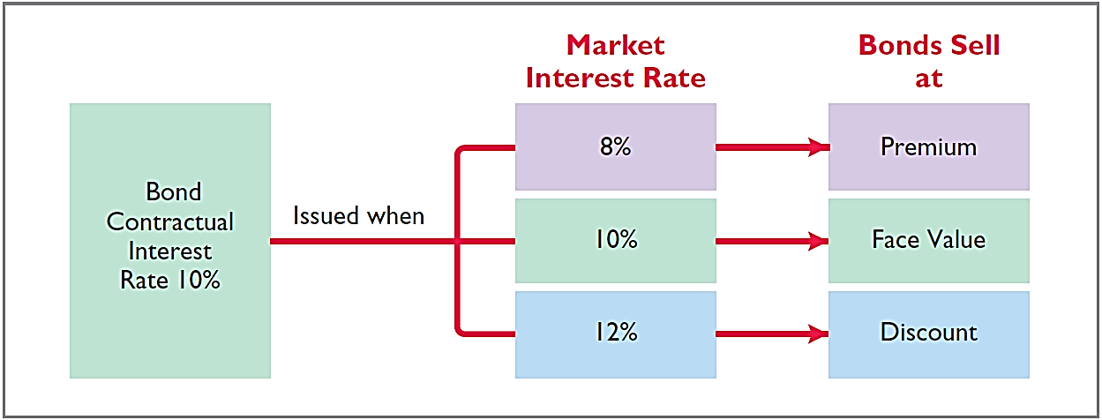
Issuing Bonds
Issue at Face Value, Discount, or Premium?
Bond Contractual Interest
Rate 10%

Slide 58
Issuing Bonds
Question
The rate of interest investors demand for loaning funds to a corporation is the:
a. contractual interest rate.
b. face value rate.
c. market interest rate.
d. stated interest rate.

Slide 59
Issuing Bonds at Face Value
Illustration: On January 1, 2017, Candlestick, Inc. issues $100,000, five-year, 10% bonds at 100 (100% of face value). The entry to record the sale is:
Jan. 1 Cash 100,000
Bonds Payable 100,000

Slide 60
Issuing Bonds at Face Value
Illustration: On January 1, 2017, Candlestick, Inc. issues $100,000, five-year, 10% bonds at 100 (100% of face value). Assume that interest is payable annually on January 1. At December 31, 2017, Candlestick recognizes interest expense incurred with the following entry.
Dec. 31 Interest Expense 10,000
Interest Payable 10,000

Slide 61
Issuing Bonds at Face Value
Illustration: On January 1, 2017, Candlestick, Inc. issues $100,000, five-year, 10% bonds at 100 (100% of face value). Assume that interest is payable annually on January 1. Candlestick records the payment on January 1, 2018 as follows.
Jan. 1 Interest Payable 10,000
Cash 10,000

Slide 62
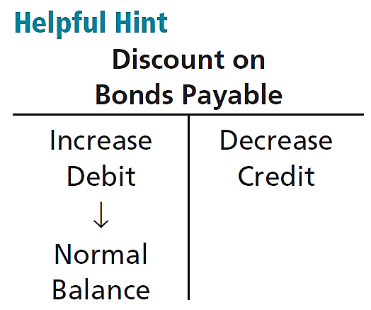
Issuing Bonds at a Discount
Illustration: On January 1, 2017, Candlestick, Inc. sells $100,000, five-year, 10% bonds for $98,000 (98% of face value). Interest is payable annually January 1. The entry to record the issuance is:
Contra account
Jan. 1 Cash 98,000
Discount on Bonds Payable 2,000
Bonds Payable 100,000

Slide 63
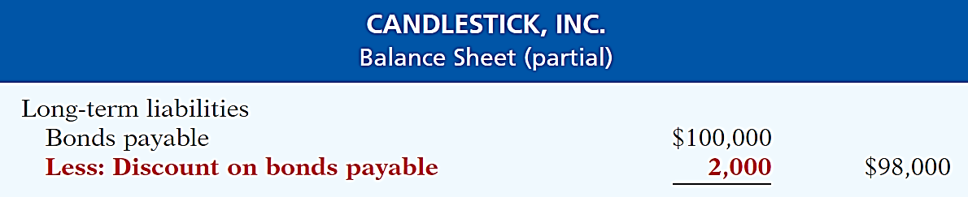
Issuing Bonds at a Discount
Statement Presentation
Carrying value or book value
Borrower is required to pay the bond discount at the maturity date. Therefore, the bond discount is considered to be an increase in the cost of borrowing.

Slide 64
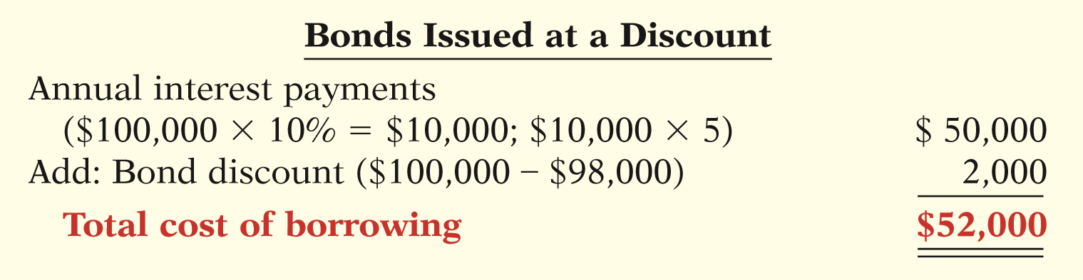
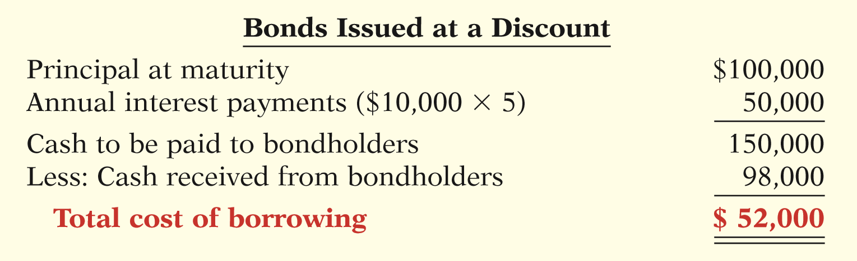
Issuing Bonds at a Discount
Total Cost of Borrowing
OR

Slide 65
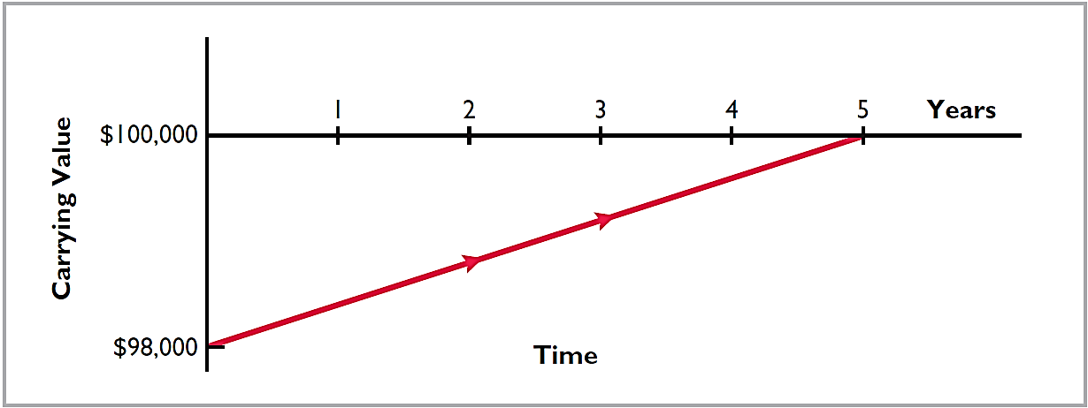
Issuing Bonds at a Discount
To follow the expense recognition principle, companies allocate bond discounts to expense in each period. This is referred to as amortizing the discount.
Thus, the amount of interest expense it reports in a period will exceed the contractual amount.

Slide 66
Issuing Bonds at a Discount
Question
Discount on Bonds Payable:
a. has a credit balance.
b. is a contra account.
c. is added to bonds payable on the balance sheet.
d. increases over the term of the bonds.

Slide 67
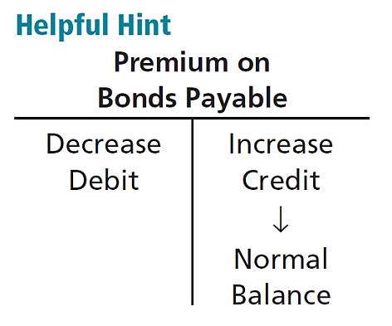
Issuing Bonds at a Premium
Illustration: On January 1, 2017, Candlestick, Inc. sells $100,000, five-year, 10% bonds for $102,000 (102% of face value). Interest is payable annually January 1. The entry to record the issuance is:
Jan. 1 Cash 102,000
Bonds Payable 100,000
Premium on Bonds Payable 2,000

Slide 68
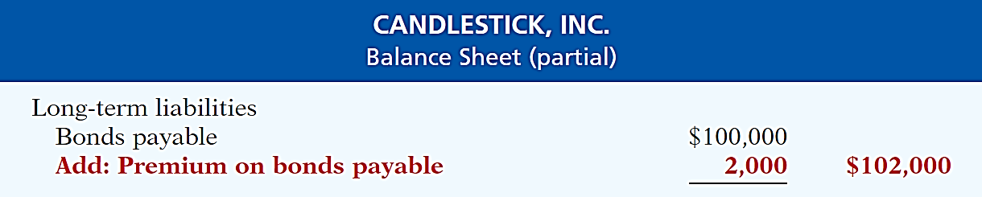
Issuing Bonds at a Premium
Statement Presentation
Borrower is not required to pay the bond premium at the maturity date of the bonds. Therefore, the bond premium is considered to be a reduction in the cost of borrowing.

Slide 69
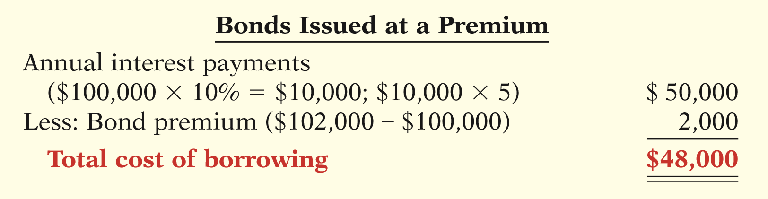
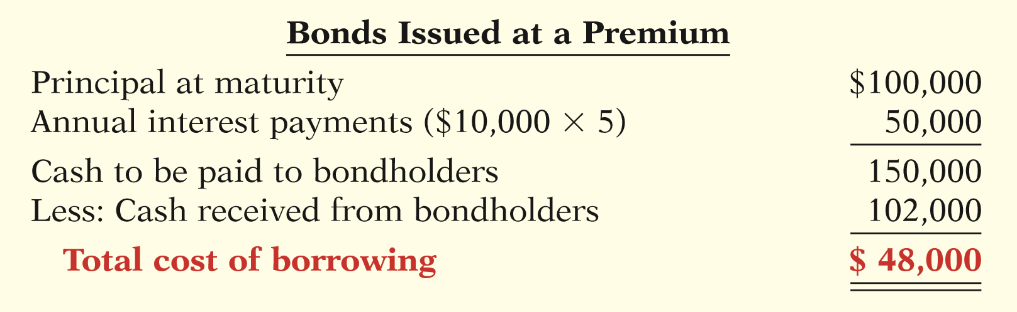
Issuing Bonds at a Premium
Total Cost of Borrowing
OR

Slide 70
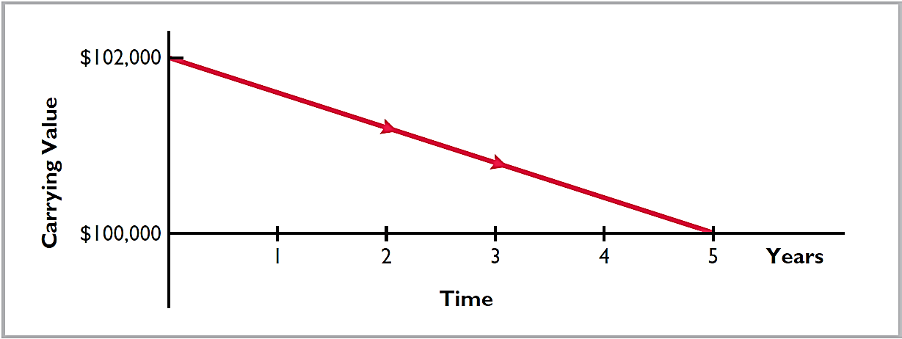
Issuing Bonds at a Premium
To follow the expense recognition principle, companies allocate bond premiums to expense in each period. This is referred to as amortizing the premium.
Thus, the amount of interest expense it reports in a period will be less than the contractual amount.

Slide 71
Issuing Bonds
Question
Karson Inc. issues 10-year bonds with a maturity value of $200,000. If the bonds are issued at a premium, this indicates that:
the contractual interest rate exceeds the market interest rate.
the market interest rate exceeds the contractual interest rate.
the contractual interest rate and the market interest rate are the same.
no relationship exists between the two rates.

Slide 72
DO IT! 3a Bond Issuance
Giant Corporation issues $200,000 of bonds for $189,000. (a) Prepare the journal entry to record the issuance of the bonds, and (b) show how the bonds would be reported on the balance sheet at the date of issuance.
Solution
(a)
Cash
189,000
Discount on Bonds Payable
11,000
Bonds Payable
200,000
(b)
Long-term liabilities
Bonds payable
$200,000
Less: Discount on bonds payable
11,000
$189,000

Slide 73
Redeeming Bonds at Maturity
Assuming that the company pays and records separately the interest for the last interest period, Candlestick records the redemption of its bonds at maturity as follows:
Jan. 1 Bonds Payable 100,000
Cash 100,000

Slide 74
Redeeming Bonds Before Maturity
When bonds are redeemed before maturity, it is necessary to:
Eliminate carrying value of bonds at redemption date.
Record cash paid.
Recognize gain or loss on redemption.
The carrying value of the bonds is the face value of the bonds less any remaining bond discount or plus any remaining bond premium at the redemption date.

Slide 75
Redeeming Bonds Before Maturity
Illustration: Assume Candlestick, Inc. has sold its bonds at a premium. At the end of the fourth period, Candlestick retires these bonds at 103 after paying the annual interest. The carrying value of the bonds at the redemption date is $100,400. Candlestick makes the following entry to record the redemption at the end of the fourth interest period (January 1, 2021):
Jan. 1 Bonds Payable 100,000
Premium on Bonds Payable 400
Loss on Bond Redemption 2,600
Cash 103,000

Slide 76
Redeeming Bonds Before Maturity
Question
When bonds are redeemed before maturity, the gain or loss on redemption is the difference between the cash paid and the:
carrying value of the bonds.
face value of the bonds.
original selling price of the bonds.
maturity value of the bonds.

Slide 77
DO IT! 3b Bond Redemption
R & B Inc. issued $500,000, 10-year bonds at a discount. Prior to maturity, when the carrying value of the bonds is $496,000, the company redeems the bonds at 98. Prepare the entry to record the redemption of the bonds.
Solution
Bonds Payable
500,000
Discount on Bonds Payable
4,000
Gain on Bond Redemption
6,000
Cash ($500,000 × 98%)
490,000

